Slide 1
Site Selection
By Rafal Broda
Interactive Map

Slide 2
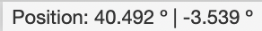



Usage
html file contains all information and can be opened in conventional internet browsers -> Firefox recommended
since map information is loaded from the Internet, Internet access is necessary
navigation analogous to Google Maps
the following tools are available:
mouse pointer geoposition indicator
search engine
layer control
measurement tool
the map contains a grid of weather data with a resolution of 5x5 km and can thus be used to pre-select suitable candidates for the Humanotop ALDEA project. For a more detailed selection, the weather data are also available with a resolution of 1x1 km

Slide 3
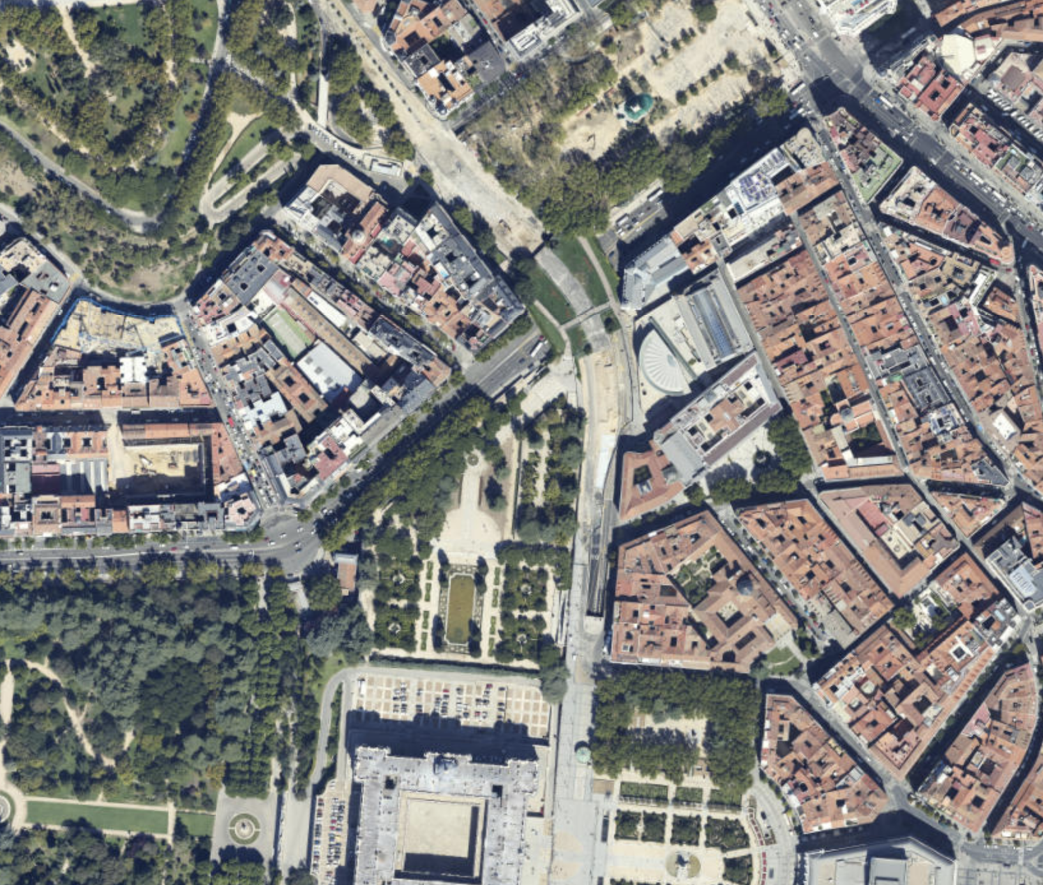
Map Data
openstreetmap with place names, streets and vegetation
Stamen Terrain with terrain profile and place names
Satellite
serves as a background on which layers of information can be placed

Slide 4
Available layers
Name | Description | Data Source (all data accessed in 01/2022)
Autonomous Communities | Communities of Spain; window with name appears on mouse click if on top | https://github.com/codeforgermany/click_that_hood/blob/main/public/data/spain-communities.geojson
Potential Abandonadas | Places with buildings where no residents are registered. Also includes industrial and vacation facilities; popup window with name, year of status, and polygon area in sq km and acres | Información Geográfica de Referencia de Poblaciones «IGR Poblaciones» en su versión 1 http://centrodedescargas.cnig.es/CentroDescargas/index.jsp
PV Potential | PV potential in kWh/kWp with legend | Longterm yearly average of Potential photovoltaic electricity production – Spain - Global Solar Atlas 2.0 https://globalsolaratlas.info
Wind Speed @10m | Wind speed in m/s with legend | This Global Wind Atlas version 3.0 https://globalwindatlas.info
Air Temperature | Mean annual air temperature in °C with legend | Longterm yearly average of air temperature – Spain - Global Solar Atlas 2.0 https://globalsolaratlas.info
Mean Annual Precipitation | Mean annual precipitation (total) in mm with legend | AEMET High-resolution (0.05 deg) daily gridded precipitation dataset for Peninsular Spain and Balearic Islands (version 2) 2021; period: 1995-2020 http://www.aemet.es/es/conocermas/recursos_en_linea/publicaciones_y_estudios/publicaciones/detalles/NT_24_AEMET
FAO90 Soil Classification | Soil name according to FAO90 Level 1; window with name appears on mouse click if on top | European Soil Database v2.0 2001 https://esdac.jrc.ec.europa.eu/content/european-soil-database-v20-vector-and-attribute-data
Seismic Hazard | Regions affected by earthquakes | Euro-Mediterranean Seismis Hazard Model 2013 (ESHM13) http://hazard.efehr.org/en/Documentation/specific-hazard-models/europe/overview/

